Slide 1
ENGINEERING BIG-DATA SYSTEMS PROJECT PRESENTATION “Yelp Dataset Analysis” April 2016
Guided By:- By:-
Prof. Dino Konstantopoulos Dishu Jindal
Pawan Matta
Rimple Talati

Slide 2
Why YELP Data-Set?
Larger data set is always welcome
We want to explore the one which is interesting and helpful in future for travelers
Four JSON files are used to do analysis –
Business
Review
User
Check-in
Notes:
Data set should be rich enough to play with it and do some analysis

Slide 3
Technologies/Languages Used
Virtualization (AWS - EMR)
Machine learning - Mahout library
Data processing language which uses Hadoop and Map-Reduce
Pig
Hive
HBase
Python
Java
R studio
Tableau

Slide 4
Initial Setup of Virtualization
We have selected Elastic Map Reduce service of AWS
Next, we are creating cluster which has 1 master and 2 slaves
While creating cluster, we have selected applications like Pig, Hive, HBase and Mahout

Slide 5
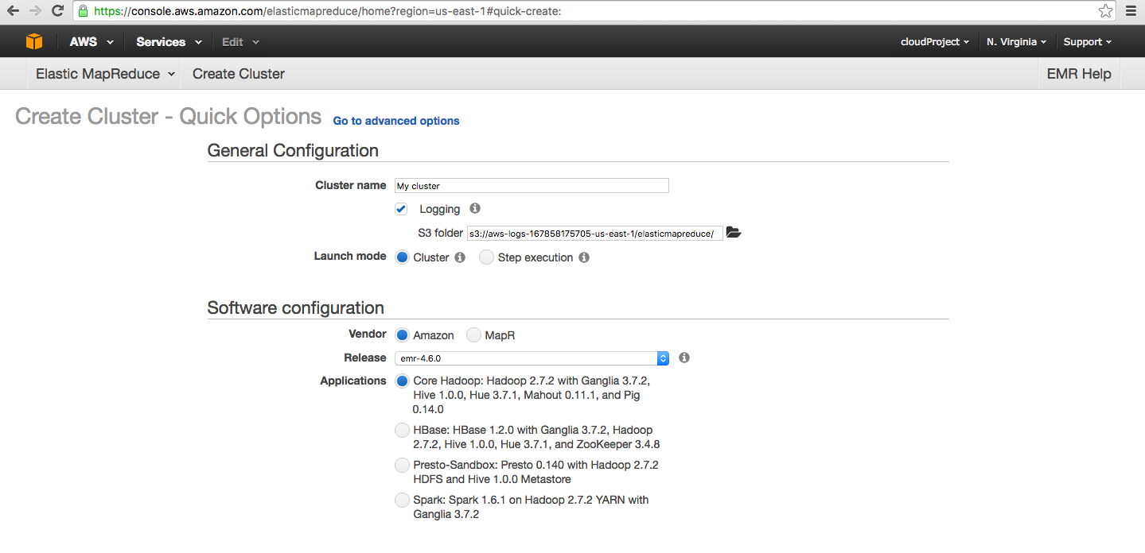
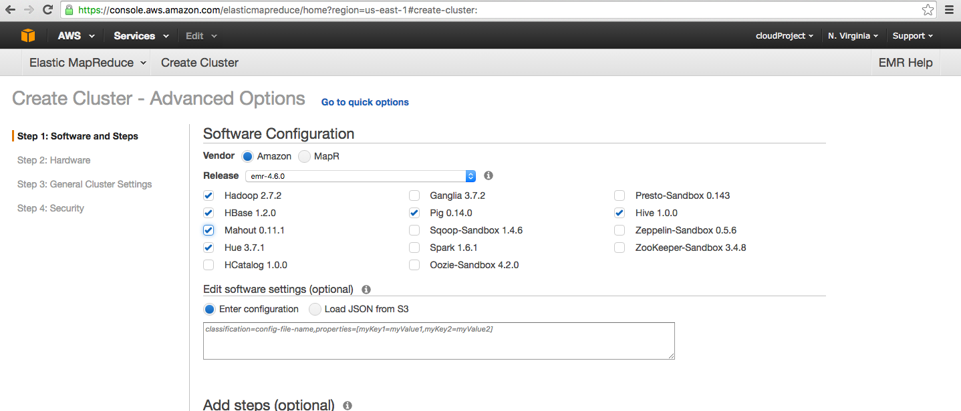
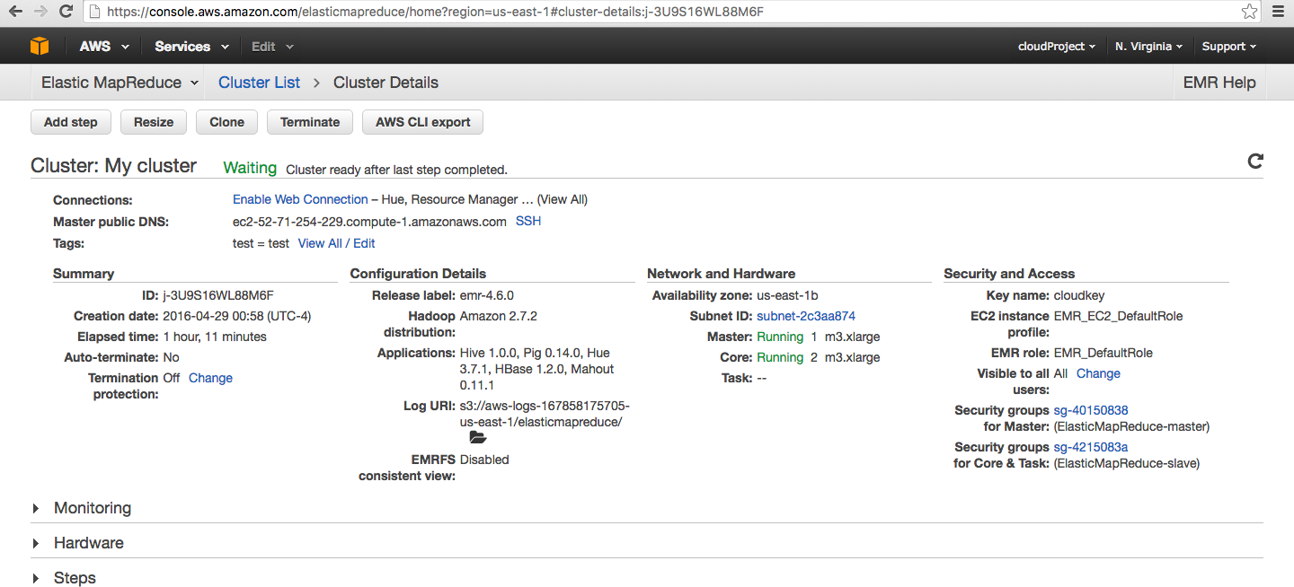

Slide 6
3 Analysis
Sentimental Analysis of user’s reviews based on business
Business Recommendations for Users
Compare the morning, afternoon and evening check-in counts of users based on the business and cities

Slide 7
Analysis 1

Slide 8
Sentimental Analysis
This analyses the reviews given by users for a particular business which helps us to find top 20 and worst 20 business reviews
We have used 2 Yelp’s json files – Business, Review
We have used Dictionary (tsv file) which consists of total 8000 words of positive and negative
Notes:
Pig, hive, hbase, R is used

Slide 9
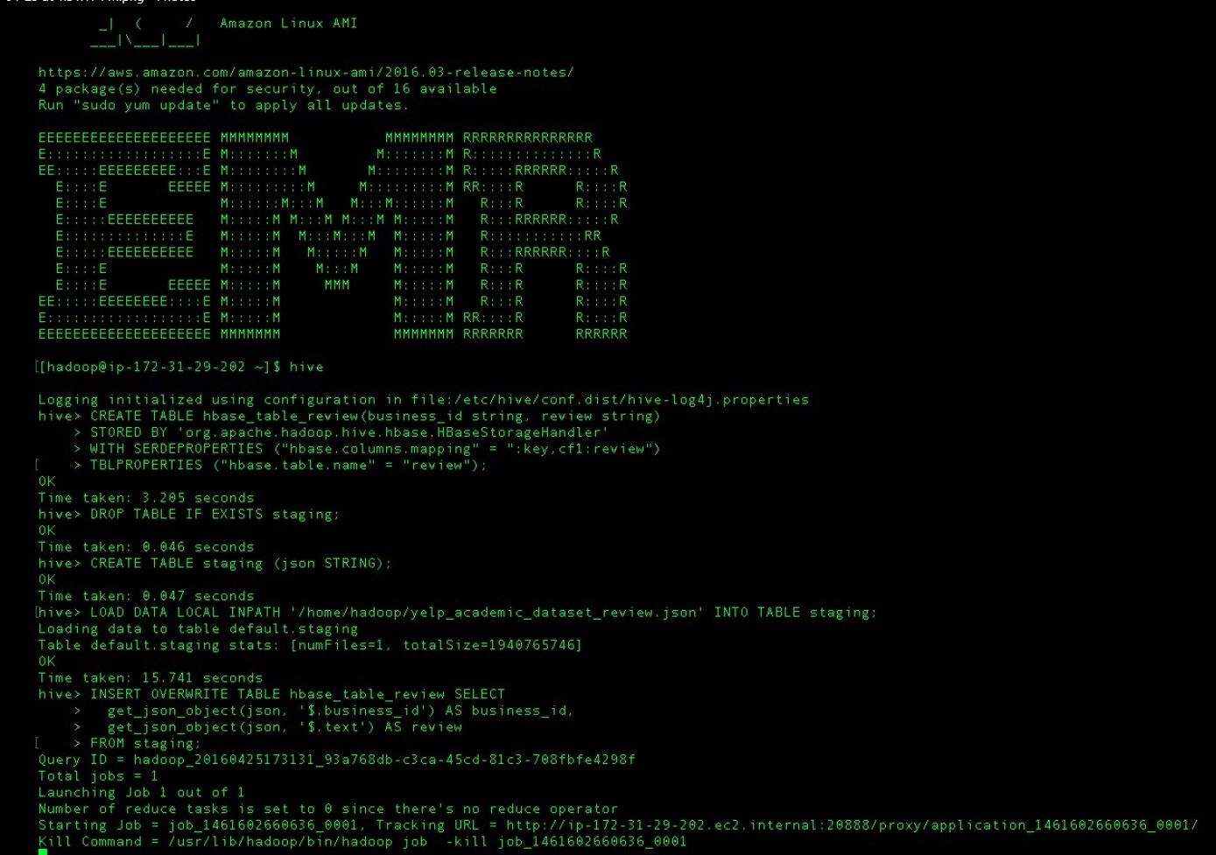
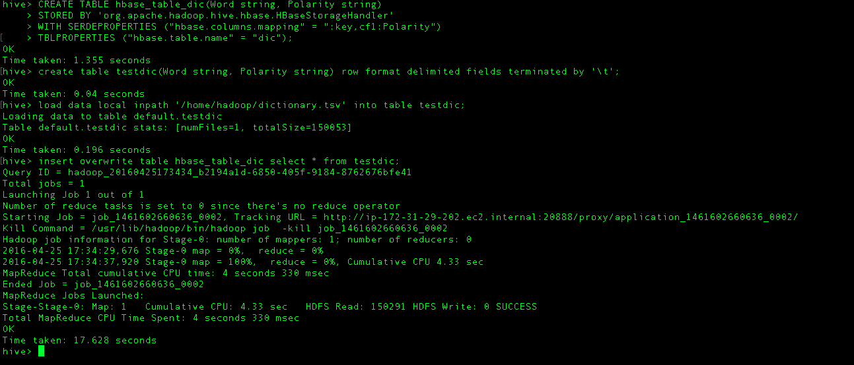
We have uploaded json and tsv file’s data to Hbase tables using HIVE script
Notes:
Creating tables in hive which then stores in hbase

Slide 10
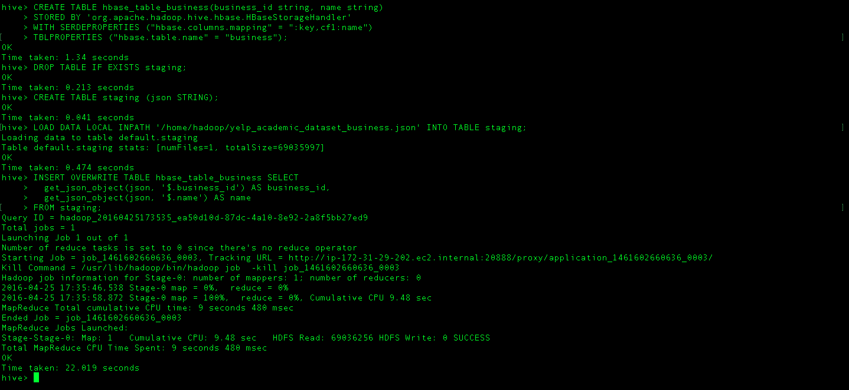

Slide 11
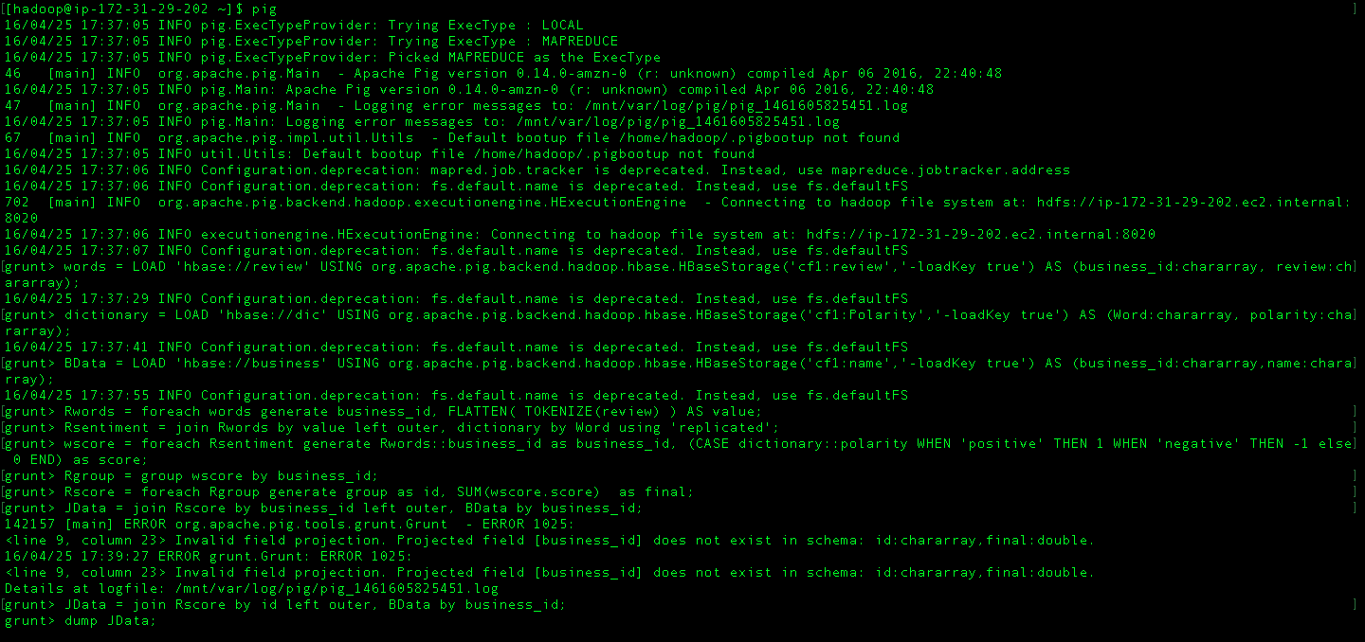
Using Pig Script, we have done sentimental analysis
Notes:
Getdata of all 3 tables from hbase, tokenize the text to get words, check these words in dictionary by join, classify each word as + or -, sum the sentiment scores for each business id
Store output in text file , copy this file from file system to EMR instance

Slide 12

We finally have our output here -

Slide 13
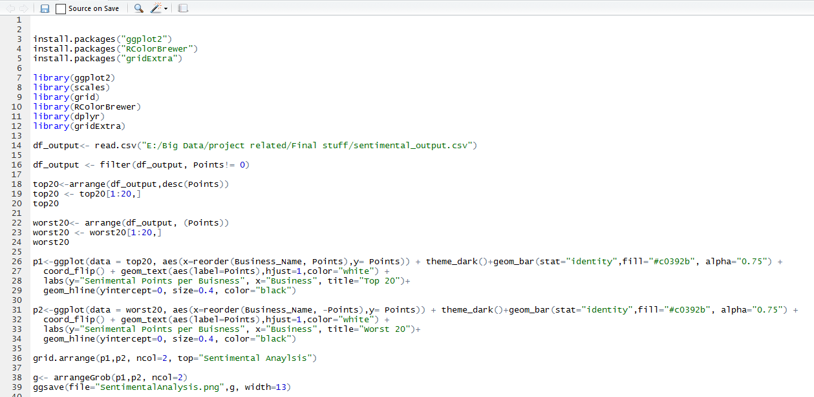
Visualization of Output using R

Slide 14
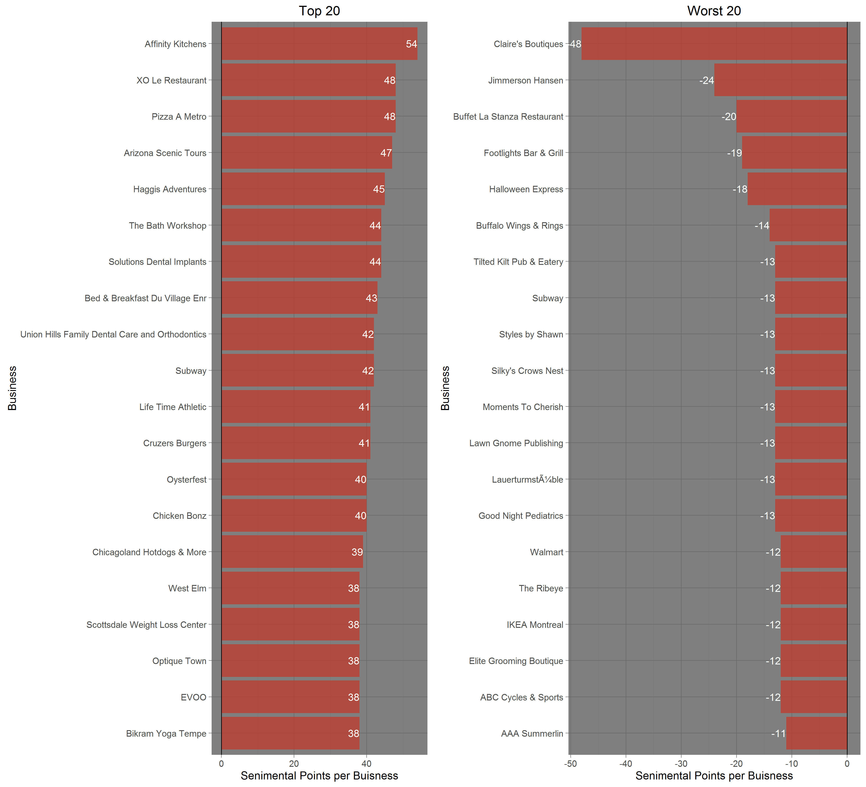
Graph output by R

Slide 15
Analysis 2

Slide 16
Business Recommendations for Users
This analysis recommends the top 10 businesses to a particular user by using Mahout library
We have used 3 Yelp’s json files – Business, Review, Users
We have created a mapping file for Business and Users which assigns a unique key to all business_id and user_id respectively

Slide 17
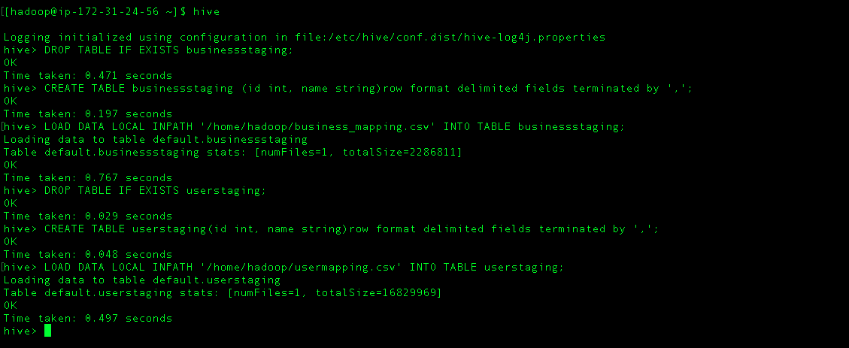
We have created staging tables in hive to store the data of these mapping file and review file

Slide 18
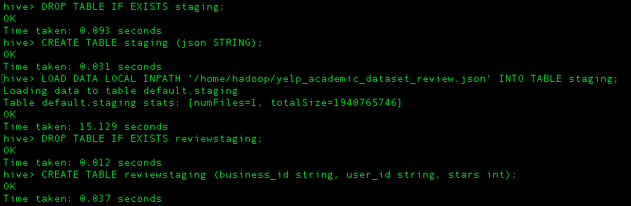
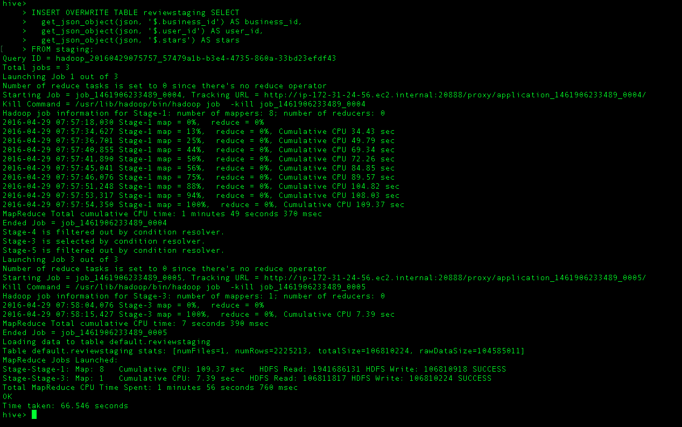

Slide 19
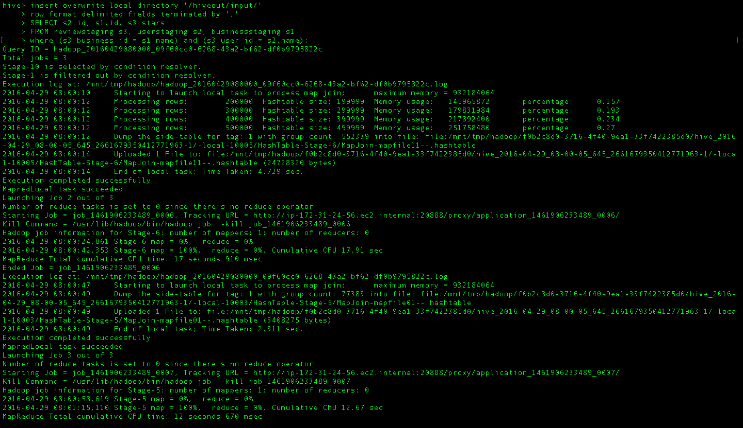
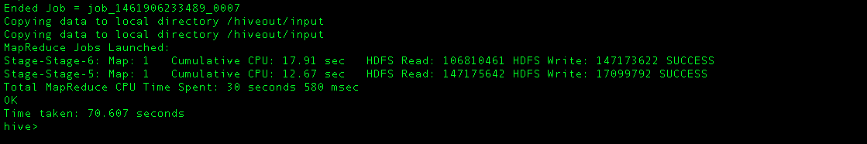
We finally got the above unique key and ratings using Hive script and saved it into csv file

Slide 20
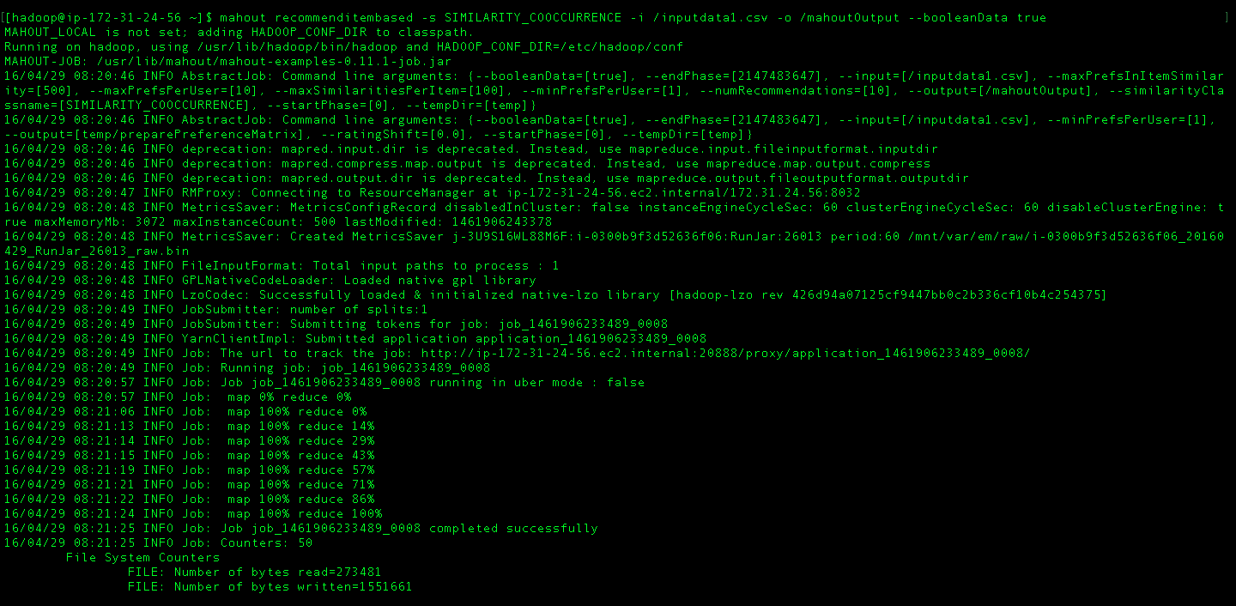
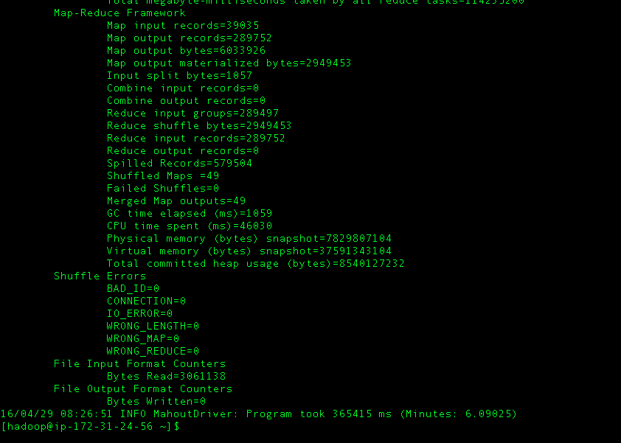
We gave this csv file as input to Mahout library and get the output in specified directory

Slide 21
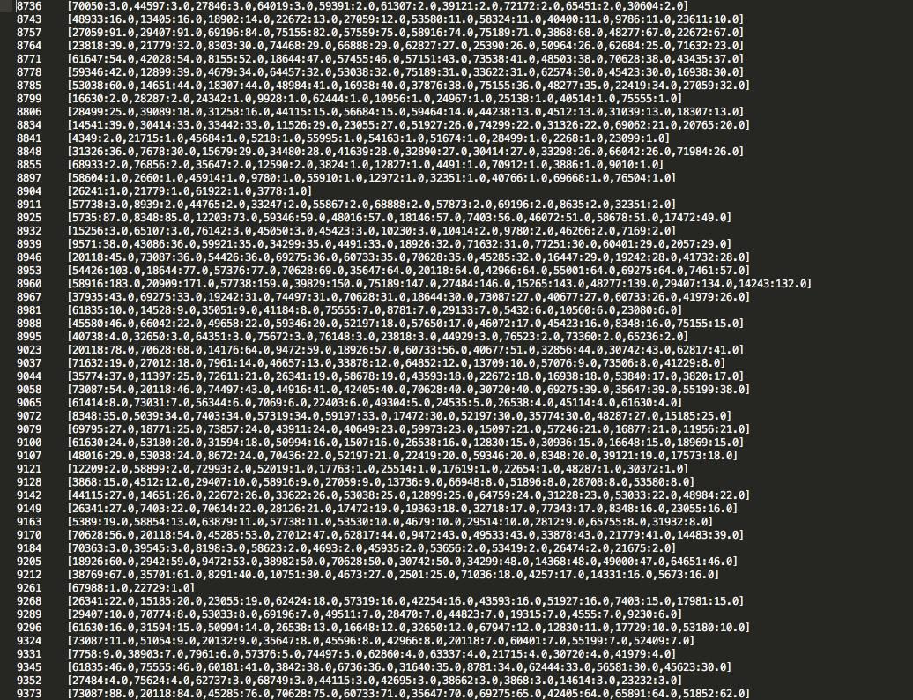
Output -
Visualization using Tableau
Visualization of Recommendation Anaylsis

Slide 22
Analysis 3

Slide 23
Check-in Analysis
This analysis compares the morning, afternoon and evening check-in counts of users based on the business and cities
We have used Check-in and Business json files
Since check-in has nested json objects which have dynamic keys, so we had written a Java code to parse the json file to clean the data

Slide 24
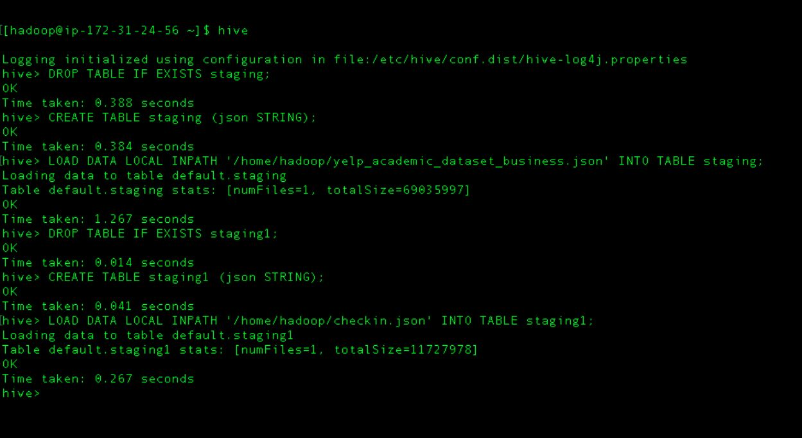
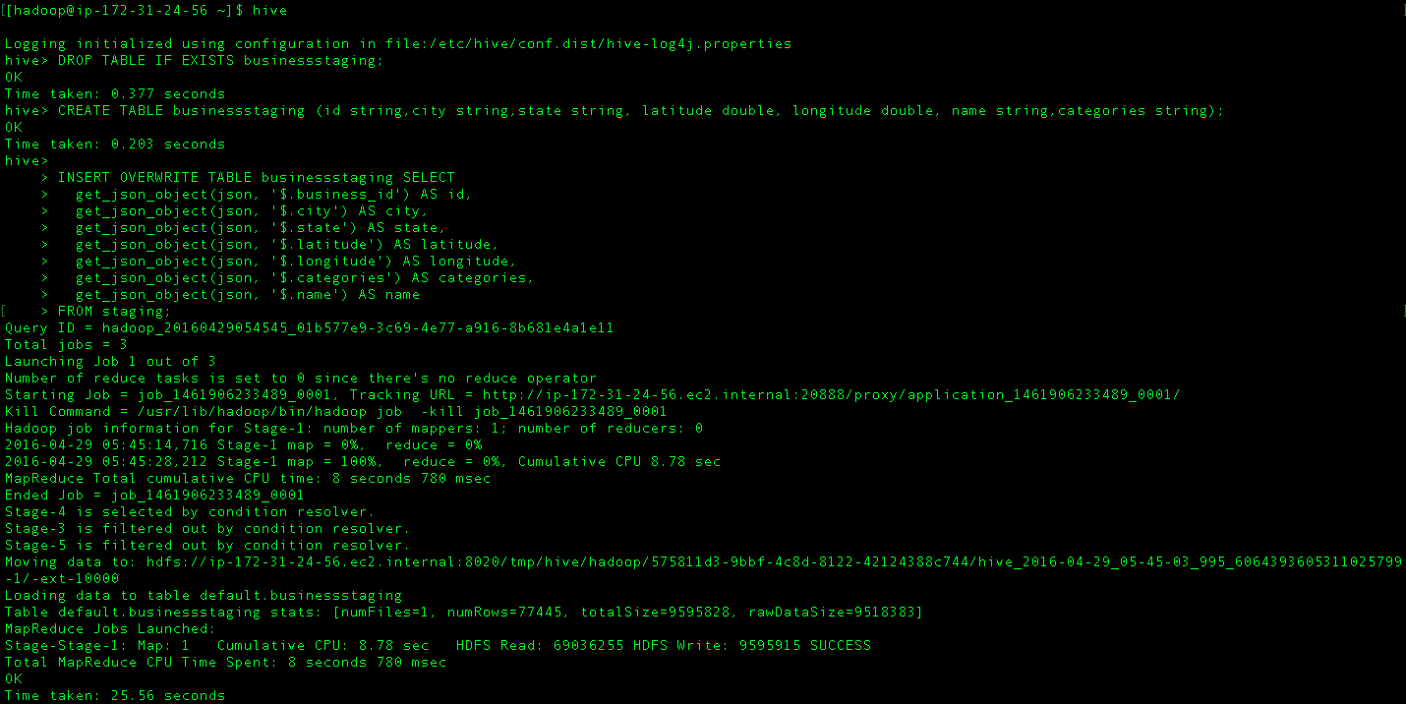
We have uploaded these data into hive staging tables

Slide 25
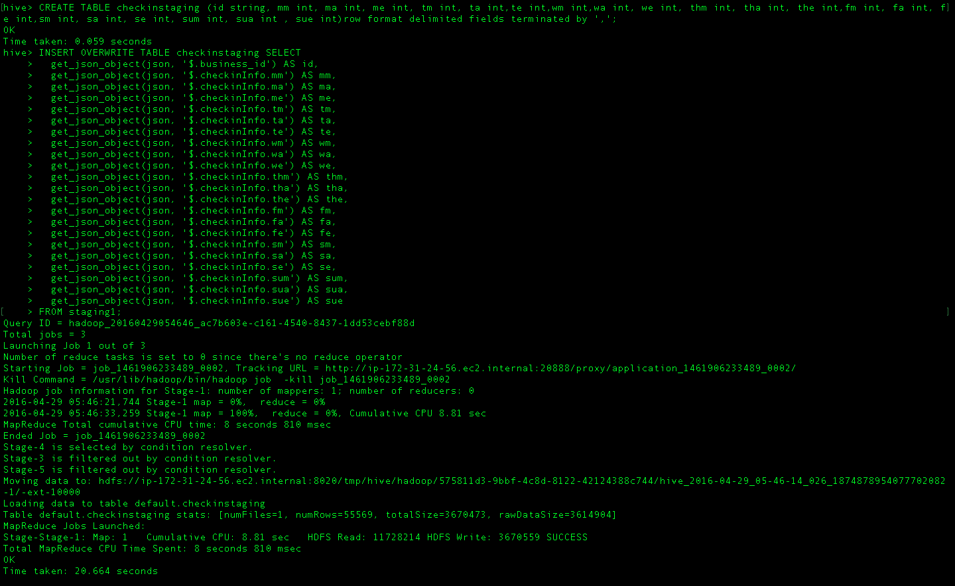
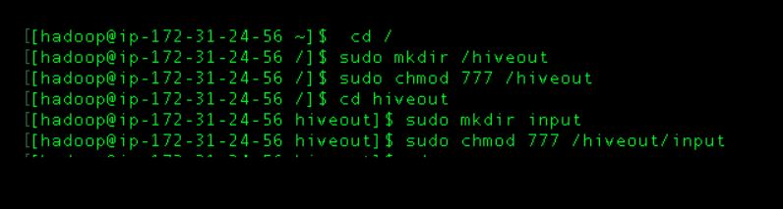

Slide 26
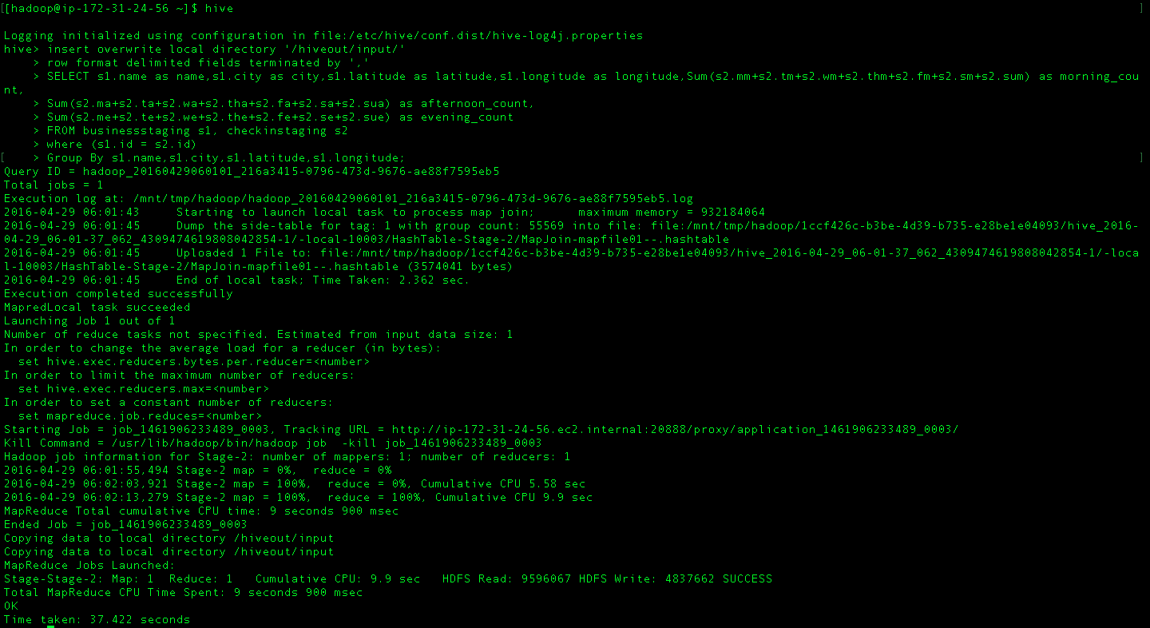
Then joined these staging tables to get the desired output

Slide 27
Visualization using Tableau
Visualization of Check-in Anaylsis

Slide 28
THANK YOU!

